Slide 1
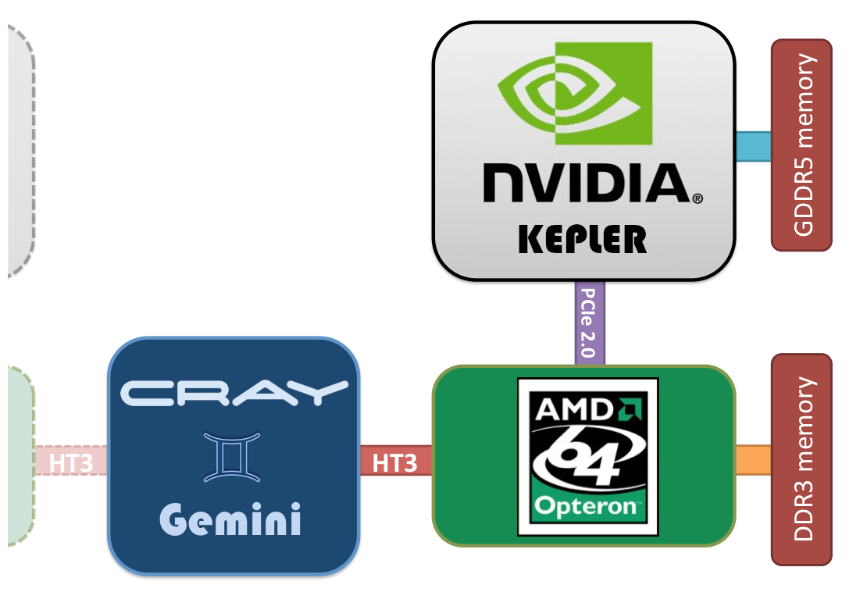


Human Supercomputer
Massively Parallel
Graphical Processor (GPU)
Has 1000’s of processing
element- make most of
Class the GPU.
Graphical Processor (GPU)
Has 1000’s of processing
element- make most of
Class the GPU.
Graphical Processor (GPU)
Has 1000’s of processing
element- make most of
Class the GPU.
Graphical Processor (GPU)
Has 1000’s of processing
element- make most of
Class the GPU.
Graphical Processor (GPU)
Has 1000’s of processing
element- make most of
Class the GPU.
Graphical Processor (GPU)
Has 1000’s of processing
element- make most of
Class the GPU.
Graphical Processor (GPU)
Has 1000’s of processing
element- make most of
Class the GPU.
Message passers- not hardware, but essential for the communication that allows the parts of the node to work together and with other nodes. – 2-4 students.
Message passers- not hardware, but essential for the communication that allows the parts of the node to work together and with other nodes. – 2-4 students.
Message passers- not hardware, but essential for the communication that allows the parts of the node to work together and with other nodes. – 2-4 students.
Message passers- not hardware, but essential for the communication that allows the parts of the node to work together and with other nodes. – 2-4 students.
Message passers- not hardware, but essential for the communication that allows the parts of the node to work together and with other nodes. – 2-4 students.
Message passers- not hardware, but essential for the communication that allows the parts of the node to work together and with other nodes. – 2-4 students.
Message passers- not hardware, but essential for the communication that allows the parts of the node to work together and with other nodes. – 2-4 students.
Central Processing Unit (CPU). Has 16 of processing elements- 1-5 students
Central Processing Unit (CPU). Has 16 of processing elements- 1-5 students
Central Processing Unit (CPU). Has 16 of processing elements- 1-5 students
Central Processing Unit (CPU). Has 16 of processing elements- 1-5 students
Central Processing Unit (CPU). Has 16 of processing elements- 1-5 students
Central Processing Unit (CPU). Has 16 of processing elements- 1-5 students
Central Processing Unit (CPU). Has 16 of processing elements- 1-5 students

Slide 2
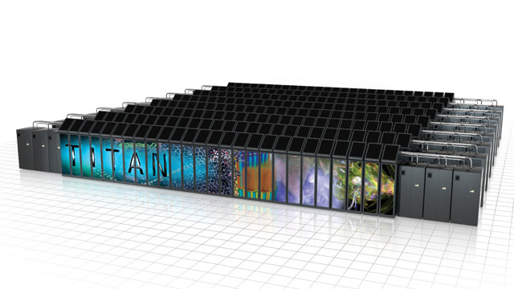
Parallel Computing
The Oak Ridge Leadership Computing Facility runs Titan, the most powerful computer for open research in the United States.
27 quadrillion calculations per second!
18,688 nodes

Slide 3
Parallel Computing
Parallel computing — Multiple processors are split up and specially adapted to work on different parts of the same task at the same time, achieving faster results.

Slide 4
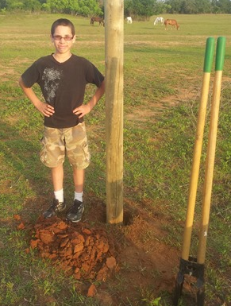
“Split up and Specially Adapted”
One person can dig a post-hole and install a fence post in 20 minutes.
If only one person works, it will take days to put in a 60 post fence.
If 60 people each put in a post, it will take less than an afternoon to put in the same fence.
VS

Slide 5
Like having 20,000 really good laptops working together to help solve a problem!

Slide 6
Why Do This?
You can calculate things you can not do with any other method.
Solve systems of literally 1000s of equations!

Slide 7
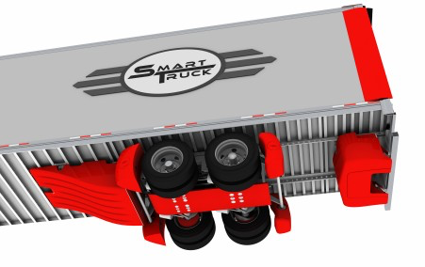
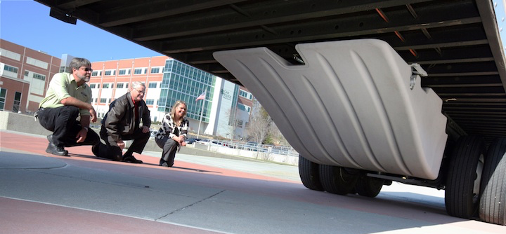
Model Engineering: Smart Truck

Slide 8
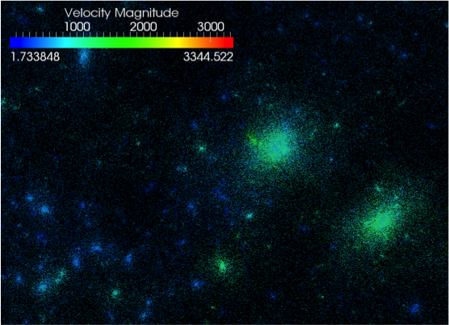
Stellar Explosions and Galaxy Formation: Dark Matter

Slide 9
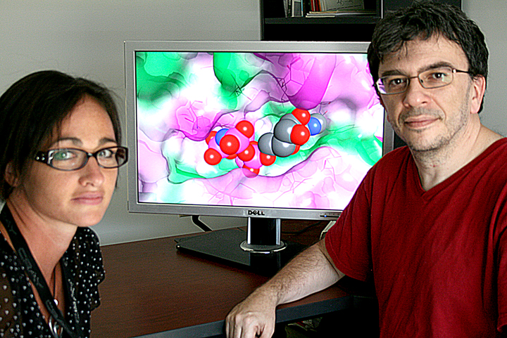
Find New Medicine: Drug Candidates and their Receptors

Slide 10
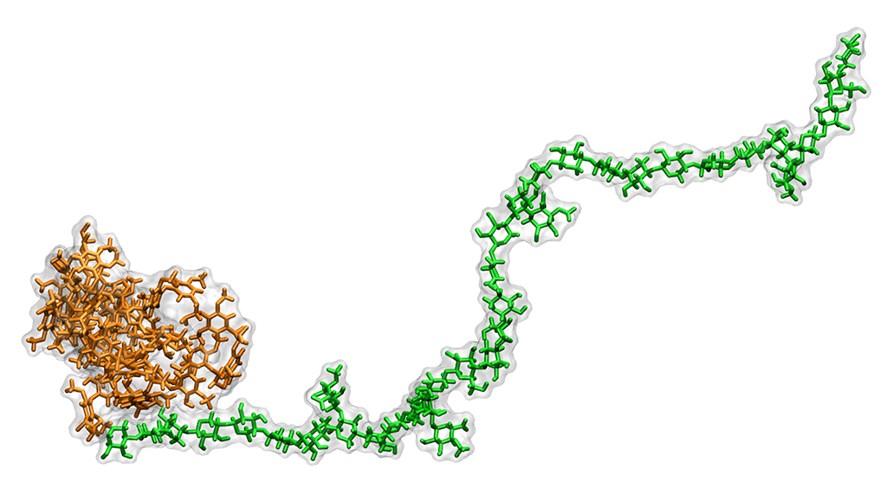
Discover New Fuel: Biofuel from Plants

Slide 11
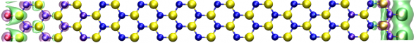
Design New Materials Starting with Atoms
Computer Chips, Communications Equipment, Solar Devices

Slide 12
Human Supercomputer
You will be divided into the teams (nodes).
Each person will be a processor.
One or two will be messengers that communicate information between processors.
Each node will race to solve a problem.
Graphical Processor (GPU)
Has 1000’s of processing
element- make most of
Class the GPU.
Graphical Processor (GPU)
Has 1000’s of processing
element- make most of
Class the GPU.
Graphical Processor (GPU)
Has 1000’s of processing
element- make most of
Class the GPU.
Graphical Processor (GPU)
Has 1000’s of processing
element- make most of
Class the GPU.
Graphical Processor (GPU)
Has 1000’s of processing
element- make most of
Class the GPU.
Graphical Processor (GPU)
Has 1000’s of processing
element- make most of
Class the GPU.
Graphical Processor (GPU)
Has 1000’s of processing
element- make most of
Class the GPU.
Message passers- not hardware, but essential for the communication that allows the parts of the node to work together and with other nodes. – 2-4 students.
Message passers- not hardware, but essential for the communication that allows the parts of the node to work together and with other nodes. – 2-4 students.
Message passers- not hardware, but essential for the communication that allows the parts of the node to work together and with other nodes. – 2-4 students.
Message passers- not hardware, but essential for the communication that allows the parts of the node to work together and with other nodes. – 2-4 students.
Message passers- not hardware, but essential for the communication that allows the parts of the node to work together and with other nodes. – 2-4 students.
Message passers- not hardware, but essential for the communication that allows the parts of the node to work together and with other nodes. – 2-4 students.
Message passers- not hardware, but essential for the communication that allows the parts of the node to work together and with other nodes. – 2-4 students.
Central Processing Unit (CPU). Has 16 of processing elements- 1-5 students
Central Processing Unit (CPU). Has 16 of processing elements- 1-5 students
Central Processing Unit (CPU). Has 16 of processing elements- 1-5 students
Central Processing Unit (CPU). Has 16 of processing elements- 1-5 students
Central Processing Unit (CPU). Has 16 of processing elements- 1-5 students
Central Processing Unit (CPU). Has 16 of processing elements- 1-5 students
Central Processing Unit (CPU). Has 16 of processing elements- 1-5 students

Slide 13

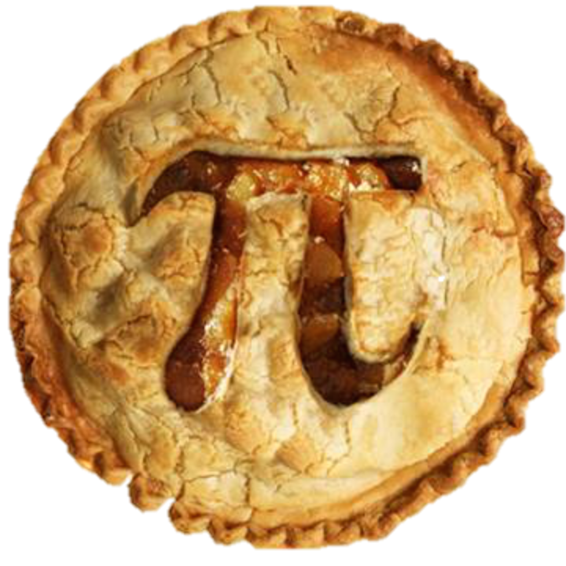
What Will We Solve?
We are going to estimate the value of π by playing darts: Monte Carlo Method.
For this exercise, forget that we now know its value is 3.14159 . . . .
Often in science we use two or three known things to find something we don’t know
Area of the board (2r)²
Area of the target:πr²
How could we “measure the areas without knowing π?

Slide 14

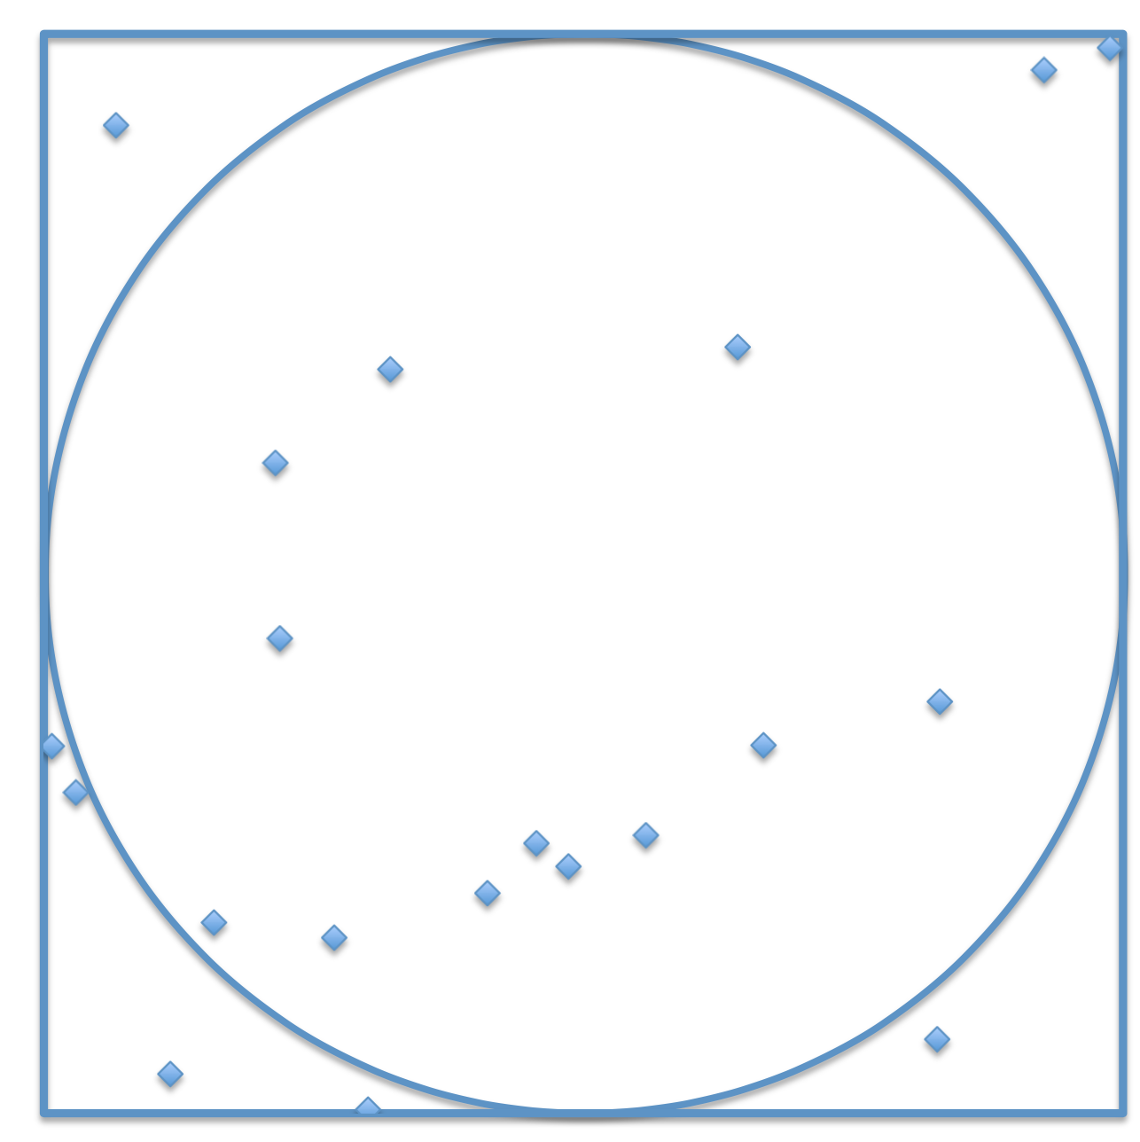
Assume your aim is only good enough to hit randomly somewhere on the board.

Slide 15
Assume your aim is only good enough to hit randomly somewhere on the board.
Throw enough darts and you will

Slide 16
Assume your aim is only good enough to hit randomly somewhere on the board.
Throw enough darts and you will
Eventually

Slide 17
Assume your aim is only good enough to hit randomly somewhere on the board.
Throw enough darts and you will
Eventually
cover

Slide 18
Assume your aim is only good enough to hit randomly somewhere on the board.
Throw enough darts and you will
Eventually
cover
The whole

Slide 19
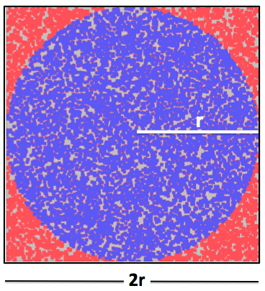
Assume your aim is only good enough to hit randomly somewhere on the board.
Throw enough darts and you will
Eventually
cover
The whole
board!

Slide 20
Playing Darts to Find π
If we have thrown enough darts to cover the board,

Slide 21
Playing Darts to Find π

Slide 22
Playing Darts to Find π
If I know that I have 400 total darts,
What can I fill in, in this equation?

Slide 23
Playing Darts to Find π
If I know that I have 400 total darts,
What can I fill in, in this equation?

Slide 24
Playing Darts to Find π
It will take all afternoon to play enough games to cover the board. . .
unless we play them all at once.

Slide 25
Playing Darts to Find π
Aim within the board is random so 400 darts on one board is the same as 20 games of 20 darts on 20 identical dartboards.
=

Slide 26
Things to Consider
A large team has the advantage for counting. A small team has the advantage for organizing the reduction.
Think about how you will sum the 20 different counts. Will you have one processor add them all up? Will you have two people added 10 each and then add the two counts? Will you find a better way?
How will you error check?

Slide 27
Summary
Pass out the dartboards.
Each person count the number of darts in the circle.
Enter the number in the array.
Sum all the values in the array.
Estimate Pi with:
Record your team’s time
Bonus: How could we get a better estimate for π?

Slide 28
Thank You!
This work used resources of the Oak Ridge Leadership Computing Facility, which is a DOE Office of Science User Facility supported under Contract DE-AC05-00OR22725.

Slide 29
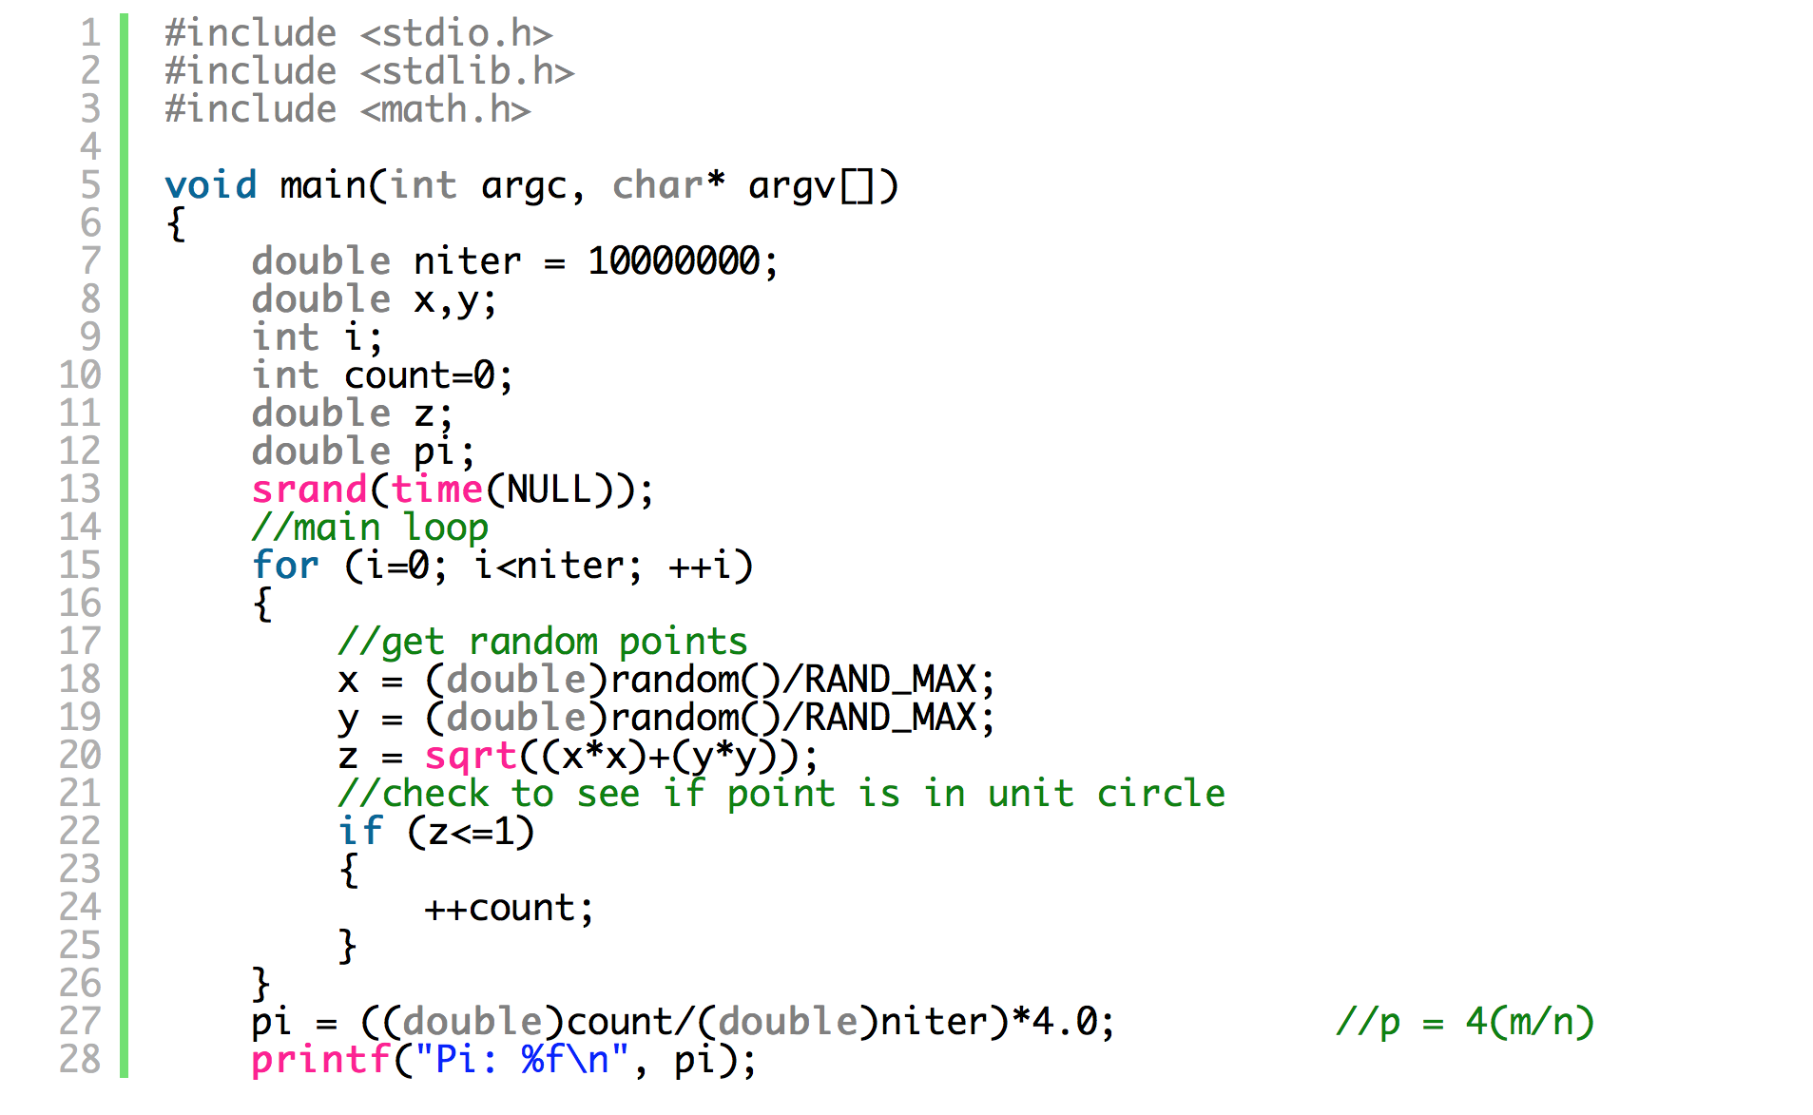
Monte Carlo Pi. C

Slide 30
Playing Darts to Find π
Kernel: Human supercomputer, count the darts in the circle on the 20 dartboards and enter them in the “array.”
Reduction: Sum the 20 counts! To get # darts circle.
Result: Put # darts circle in the equation below to get your estimate for Pi, then report your result to us. You will be timed. The fastest team wins.

